Slide 1
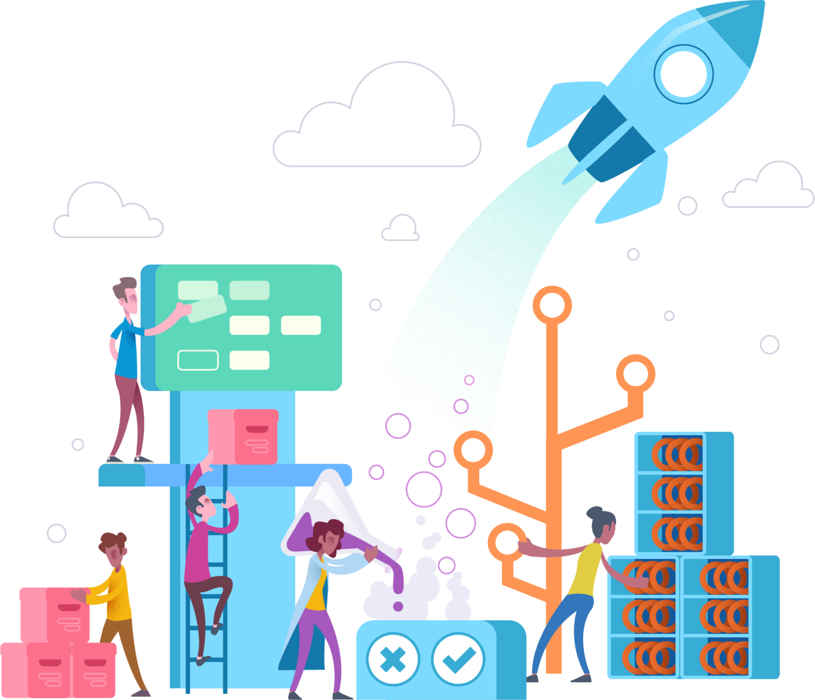
Modern Application Architecture in Azure
Tim Baggs
Principal Development Architect

Slide 2
History of “modern” Architecture
N-Tier Architecture
Service-Oriented Architecture
Software-as-a-Service
The 12 Factor App

Slide 3
History of “modern” Architecture
N-Tier Architecture
Challenges
Tight-coupling
Long development cycles
Scale one, scale all
Presentation
Domain Logic
Data Storage

Slide 4
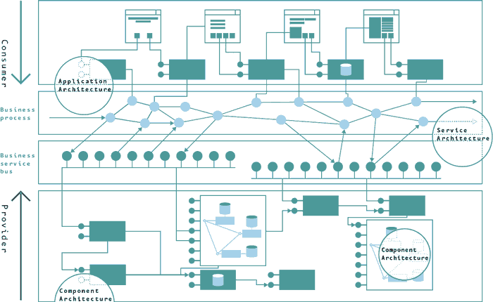
History : Service-Oriented Architecture
“The policies, practices, frameworks that enable application functionality to be provided and consumed as sets of services published at a granularity relevant to the service consumer.
Services can be invoked, published and discovered, and are abstracted away from the implementation using a single, standards-based form of interface.”
Services are discoverable and leverage components
Services are consumed by apps via “light-weight” service bus.
Services are orchestrated into business processes
apps
business processes
service bus
Business services
Challenges
The rise of ESBs (which included message routing, transformations, logic operations, orchestration, etc.), resulted in tight coupling between internal and external components
Centralized governance policies inhibited agility and creativity
components

Slide 5
History: Software as a Service (SaaS)
“A software distribution model in which a service provider hosts applications for customers and makes them available to these customers via the internet.” [www.infoworld.com]
The twelve-factor app is a methodology for building software-as-a-service apps that:
Use declarative formats for setup automation, to minimize time and cost for new developers joining the project
Have a clean contract with the underlying operating system, offering maximum portability between execution environments
Are suitable for deployment on modern cloud platforms, obviating the need for servers and systems administration
Minimize divergence between development and production, enabling continuous deployment for maximum agility
Can scale up without significant changes to tooling, architecture, or development practices.
[12factor.net]

Slide 6
History: The 12 Factors
I. Codebase
One codebase tracked in revision control, many deploys
II. Dependencies
Explicitly declare and isolate dependencies
III. Config
Store config in the environment
IV. Backing services
Treat backing services as attached resources
V. Build, release, run
Strictly separate build and run stages
VI. Processes
Execute the app as one or more stateless processes
VII. Port binding
Export services via port binding
VIII. Concurrency
Scale out via the process model
IX. Disposability
Maximize robustness with fast startup and graceful shutdown
X. Dev/prod parity
Keep development, staging, and production as similar as possible
XI. Logs
Treat logs as event streams
XII. Admin processes
Run admin/management tasks as one-off processes
[12factor.net]

Slide 7
Microservices
Definition
The microservice architectural style is an approach to developing a single application as a suite of small services, each running in its own process and communicating with lightweight mechanisms, often an HTTP resource API. These services are built around business capabilities and independently deployable by fully automated deployment machinery. There is a bare minimum of centralized management of these services, which may be written in different programming languages and use different data storage.
“
”
- James Lewis & Martin Fowler

Slide 8
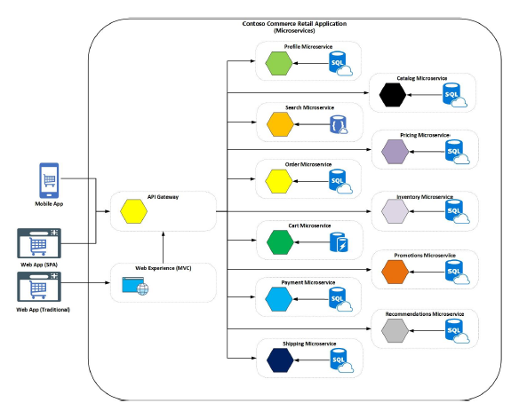
Characteristics
Services implement single business or technical concern (single responsibility principle)
Each service has its own data repository
Services are developed, deployed and scaled independently
Clients access the services through well-defined APIs or Messages
Services run in their own processes and/or containers

Slide 9
Benefits
Independent deployments
Independent development
Small, focused teams
Fault isolation
Mixed technology stacks
Granular scaling

Slide 10
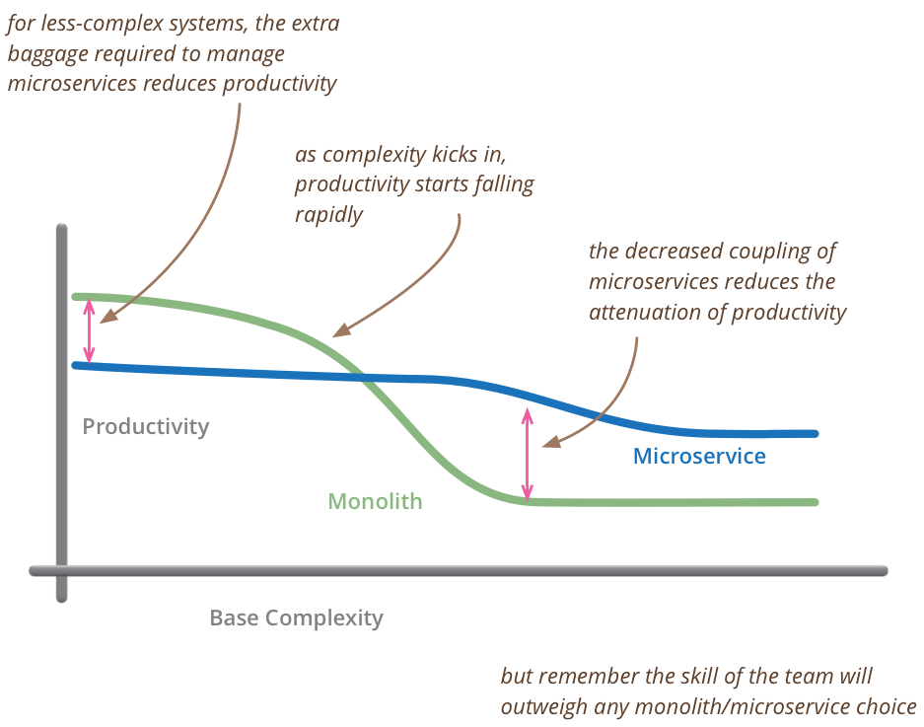
Challenges
Complexity
Service boundaries
Data consistency/integrity
Network congestion/latency
Client communication
DevOps
- Martin Fowler

Slide 11
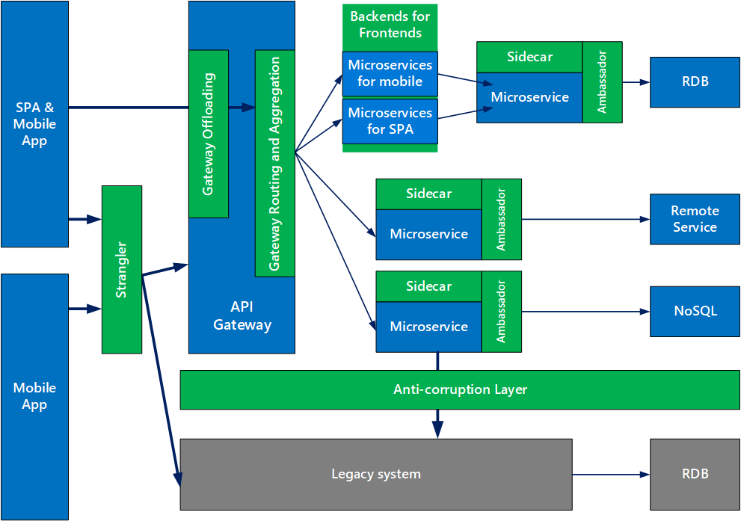
Microservices Consider for:
Apps with many subdomains
Scaling towards multiple teams
Require high release velocity
Require granular scalability

Slide 12
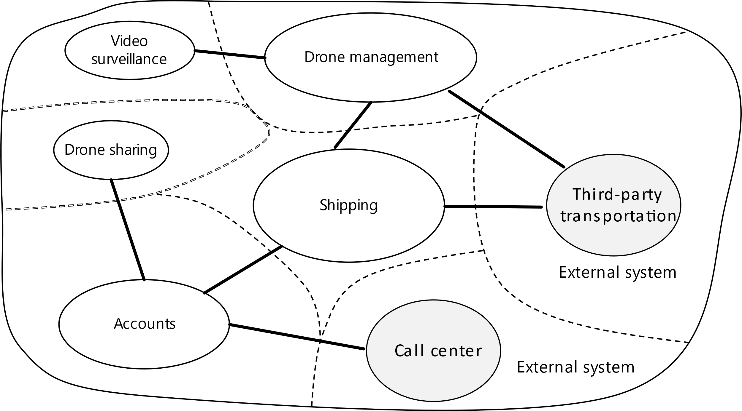
Service boundaries
Analyze domain
Define bounded contexts
Define entities, aggregates & services
Identity microservices
“
A bounded context is simply the boundary within a domain where a particular domain model applies.
”
- Domain-driven Design by Eric Evans

Slide 13
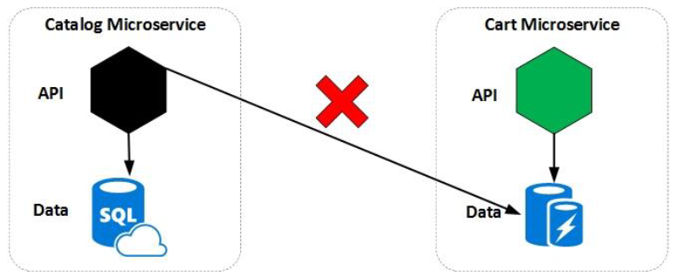
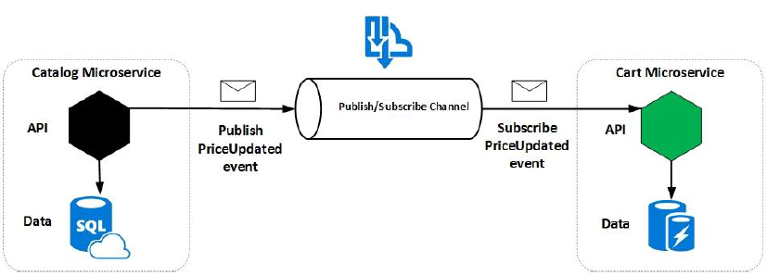
Data considerations
Every service manages its own data
No sharing of data stores between services
Service might represent the source of truth for a given entity («master»)
Other services might hold a subset of the entity
Embrace eventual consistency (no distributed transactions)
Profit from polyglot persistence

Slide 14

Interservice communication
Synchronous Communication
Synchronous communication. In this pattern, a service calls an API that another service exposes, using a protocol such as HTTP or gRPC. This option is a synchronous messaging pattern because the caller waits for a response from the receiver. Typically RESTful APIs are external-facing or exposed towards the UI. Callers must implement retry and timeouts for resiliency. APIs must be semantically versioned.
UI
Synchronous
Asynchronous Communication
Service Bus
Asynchronous message passing. In this pattern, a service sends messages without waiting for a response, and one or more services process the message asynchronously. Typically inter-service communication is implemented via asynchronous messaging using AMQP or similar protocols. Resilience is built into the underlying service bus, which follows the paradigm “smart endpoints and dumb pipes”. Messages must be semantically versioned.
Asynchronous

Slide 15
Workflows
Send
Subscribe
Publish
Event
Orchestration
Choreography
Less coupling
More transparency

Slide 16
Team boundaries
Organizations which design systems are constrained to produce designs which are copies of the communication structures of these organizations.
“
”
- Melvin E. Conway
Fine-grained communication required for developing a single microservice, many choose small co-located team who owns a microservice (“2 pizza teams“)
Coarse-grained communication required between loosely coupled teams in order to scale, following no requirement for co-location but for stable and versioned APIs
Align domain, service and team boundaries

Slide 17
DevOps
DevOps is the union of people, process, and technology to enable continuous delivery of value to customers. DevOps, a compound of dev (development) and ops (operations), is a software development practice that unifies development and IT operations. The meaning signifies coordination and collaboration among formerly siloed disciplines. Quality engineering and security teams also become part of the broader team in the DevOps model.
Continuous Integration (CI)
Improve software development quality and speed.
When you use Azure Pipelines or Jenkins to build apps in the cloud and deploy to Azure, each time you commit code, it’s automatically built and tested and bugs are detected faster.
Continuous Deployment (CD)
By combining continuous integration and infrastructure as code (IaC), you’ll achieve identical deployments and the confidence to deploy to production at any time.
With continuous deployment, you can automate the entire process from code commit to production if your CI/CD tests are successful.
Continuous Learning & Monitoring
With Azure Application Insights you can identify how your applications are performing and test if the recent deployment made things better or worse.
Using CI/CD practices, paired with monitoring tools, you’ll be able to safely deliver features to your customers as soon as they’re ready.

Slide 18
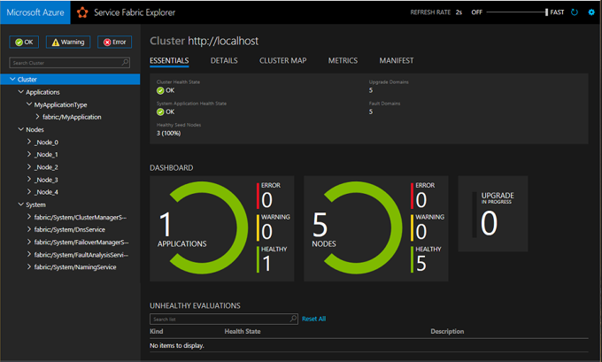
Continuous learning & monitoring
+ CorrelationId
Microservice
Logging
System
Application monitoring
+ Drill-down into microservice

Slide 19
Design Patterns

Slide 20
What is a design pattern?
Reusable solutions to commonly occurring problems within a given context.
Formalized best practice that can be used to solve common problems.
“Each pattern describes a problem which occurs over and over again in our environment and then describes the core of the solution to that problem, in such a way that you can use this solution a million times over, without ever doing it in the same way twice”
Christopher Alexander, A Pattern Language, 1977
Notes:
SPEAKER NOTES:

Slide 21
Design Patterns for Microservices
API Gateway
Ambassador
Sidecar
Strangler
Anti-corruption layer
Bulkhead
Gateway Offloading
Circuit Breaker
Cache-Aside
Notes:
SPEAKER NOTES:
There are numerous design patterns that are applicable to microservices, don’t have time to cover them all. These are just a few of the key patterns.

Slide 22
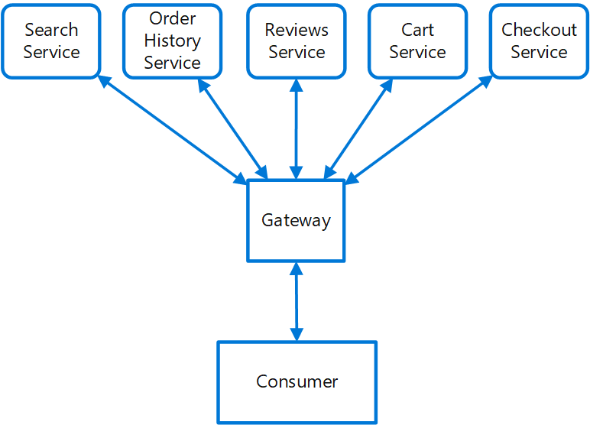
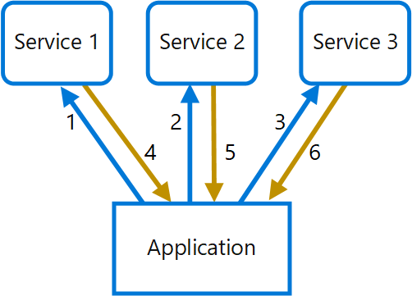
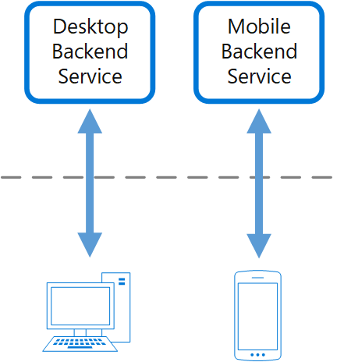
API Gateway
Problem How do clients of microservices-based applications access the individual services?
Solution Use an API gateway to define routes and endpoints in configuration where each route is associated to an endpoint to handle that route.
API Gateway/Gateway Routing
Place a gateway in front of a set of applications, services, or deployments.
Client application only needs to know about and communicate with a single endpoint.
Gateway Aggregation
Use a gateway to reduce chattiness between the client and the services.
Gateway receives client requests, dispatches requests to the various backend systems, and then aggregates the results and sends them back to the requesting client.
Backend for Front-end
Create one backend per user interface. Fine tune behavior and performance of each backend to best match the needs of frontend environment, without worrying about affecting other frontend experiences.
Notes:
SPEAKER NOTES:
Variations – gateway routing, gateway aggregation, backend for frontend,

Slide 23
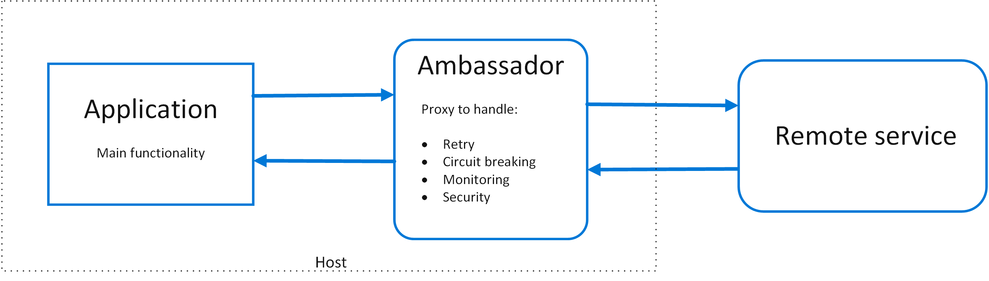
Ambassador
Problem
How do you retrofit legacy apps with fundamental cloud native capabilities to be resilient, fault tolerant (retry logic, circuit breaker, bulkhead)?
Solution
Put client frameworks and libraries into an external process that acts as a proxy between your application and external services.
Deploy the proxy on the same host environment as your application to allow control over routing, resiliency, security features, and to avoid any host-related access restrictions.
Features that are offloaded to the ambassador can be managed independently of the application. You can update and modify the ambassador without disturbing the application's legacy functionality.

Slide 24
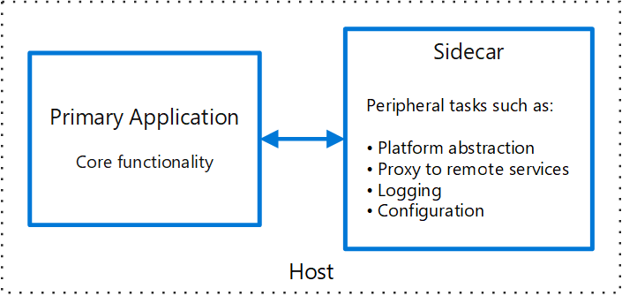
Sidecar
Problem
Applications and services often require related functionality, such as monitoring, logging, configuration, and networking services. How can one implement such functionality in a loosely coupled, isolated fashion?
Solution
Co-locate a cohesive set of tasks with the primary application, but place them inside their own process or container, providing a homogeneous interface for platform services across languages.
Sidecar characteristics
Is independent from its primary app in terms of runtime environment and programming language
Can access the same resources as the primary app.
No significant communication latency to primary app.
Often used with containers and referred to as a sidecar container or sidekick container.

Slide 25
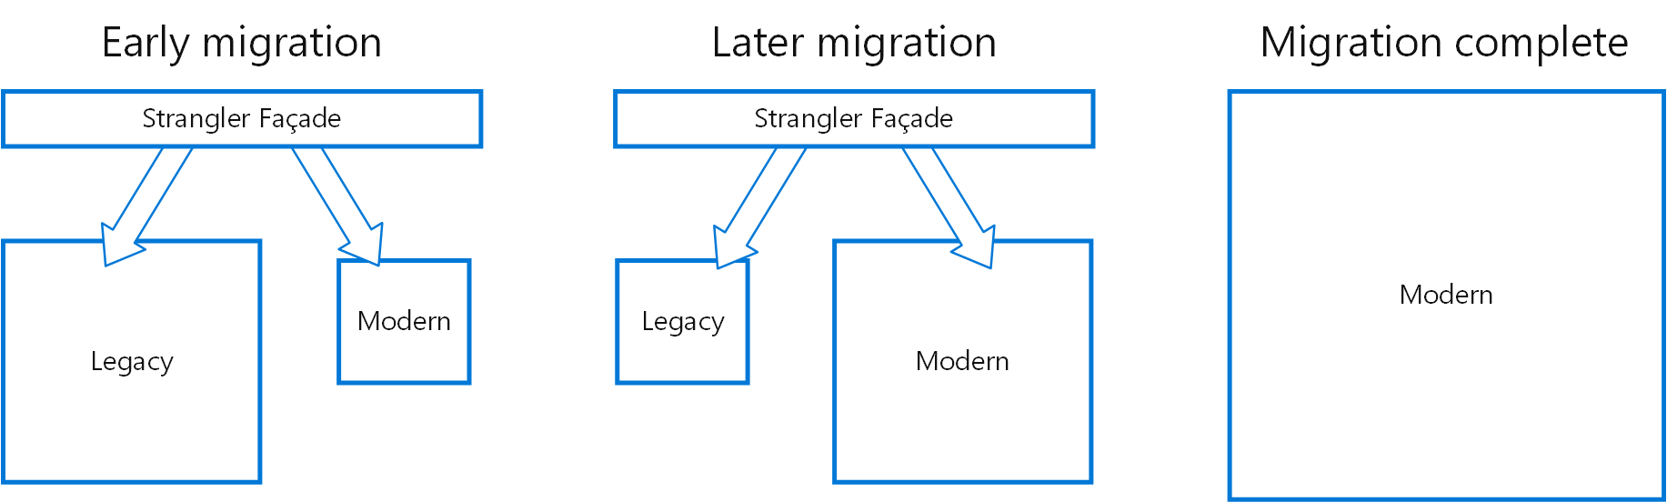
Strangler
Problem How do I incrementally modernize and migrate a legacy system to new methods and methodologies while mitigating the risk of a big cut-over?
Solution Incrementally replace specific pieces of functionality with new applications and services. Create a façade that intercepts requests going to the backend legacy system. The façade routes these requests either to the legacy application or the new services. Existing features can be migrated to the new system gradually, and consumers can continue using the same interface, unaware that any migration has taken place.
Notes:
SPEAKER NOTES:
Use strangler, instead of big cut-over, to mitigate risks
When moving from a monolith, build the system around the edges of the old, growing it slowly until it takes over the old, much like a strangler vine slowly killing off a tree that it climbs on

Slide 26
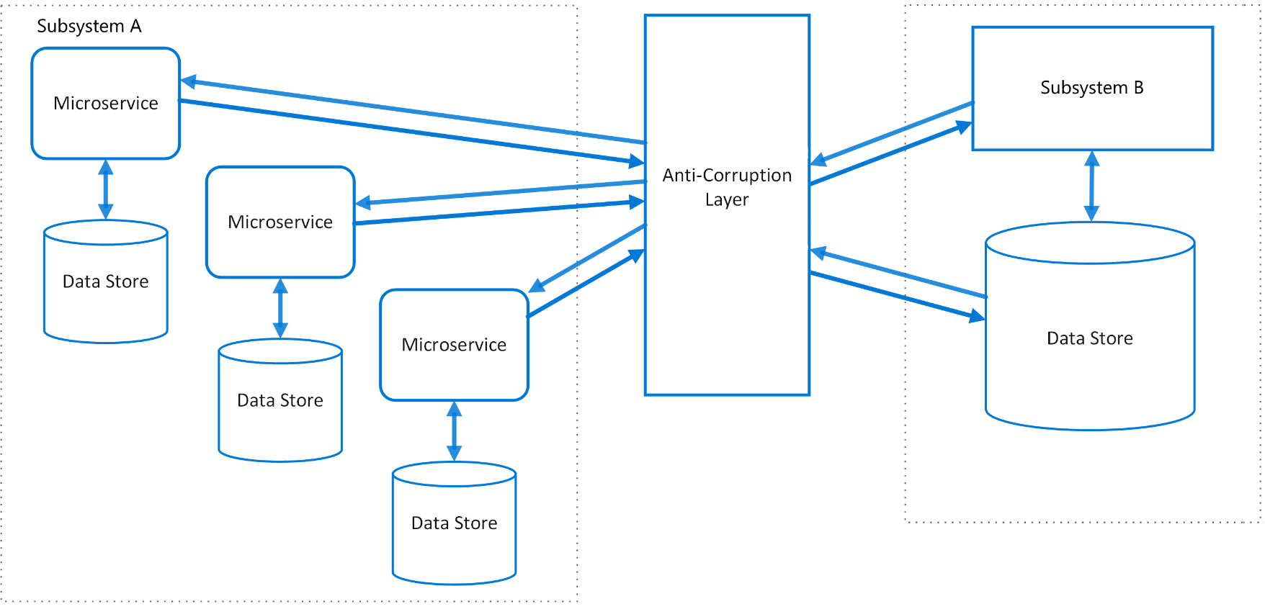
Anti-Corruption Layer
Problem Applications rely on other systems for some data or functionality. When a legacy appl is modernized, it may still need existing legacy resources. New features must be able to call the legacy system.
Legacy systems often suffer from quality issues due to convoluted data schemas or obsolete APIs. Features and technologies used in legacy systems can vary widely from more modern systems. For interop, new app may need to support outdated infrastructure, protocols, data models, APIs, or other features that you wouldn't otherwise put into a modern application.
Similar issues can arise with any external system.
Solution Isolate the different subsystems by placing an anti-corruption layer between them. This layer translates communications between the two systems, allowing one system to remain unchanged while the other can avoid compromising its design and technological approach.
Notes:
SPEAKER NOTES:
The diagram above shows an application with two subsystems. Subsystem A calls to subsystem B through an anti-corruption layer. Communication between subsystem A and the anti-corruption layer always uses the data model and architecture of subsystem A. Calls from the anti-corruption layer to subsystem B conform to that subsystem's data model or methods. The anti-corruption layer contains all of the logic necessary to translate between the two systems. The layer can be implemented as a component within the application or as an independent service.
Pattern originated from DDD as a means of linking two bounded contexts.
Use
When refactoring legacy into new – prevents shinny new system from being “corrupted”/polluted by legacy semantics
To isolate your system from 3rd party dependencies; when 3rd party changes, your code changes are limited to this layer
Considerations
Introduces additional latency
May not be necessary/suitable if 2 subsystems have limited semantic differences

Slide 27
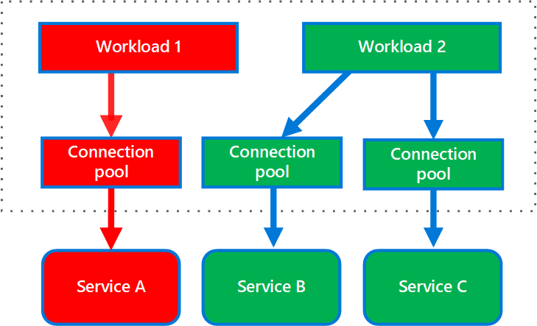
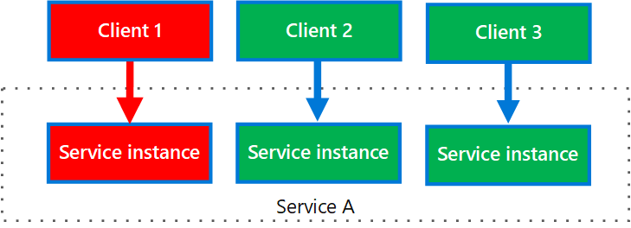
Bulkhead
Problem How can you seal off sections of your application in order to isolate them and prevent cascading errors?
Solution Partition service instances into different groups, based on consumer load and availability requirements. This design helps to isolate failures, and allows you to sustain service functionality for some consumers, even during a failure.
A consumer can also partition resources, to ensure that resources used to call one service don't affect the resources used to call another service. For example, a consumer that calls multiple services may be assigned a connection pool for each service. If a service begins to fail, it only affects the connection pool assigned for that service, allowing the consumer to continue using the other services.
Example Single service implemented in a containerized environment as a discrete container with defined resource requests and limits for CPU and memory.

Slide 28
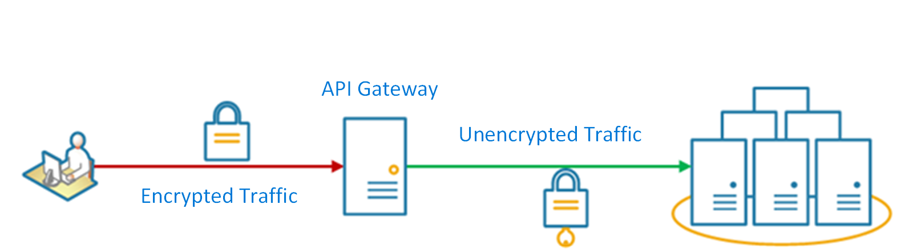
Gateway Offloading
Problem Features such as token validation, HTTPS certificate, encryption, authZ, authN. These features require development, configuration management, and maintenance. Deploying such features with each service increases the maintenance overhead.
Solution Offload some features into an API gateway, particularly cross-cutting concerns such as certificate management, authentication, SSL termination, monitoring, protocol translation, or throttling.
Considerations Features such as token validation, HTTPS certificate, encryption, authZ, authN. These features require development, configuration management, and maintenance. Deploying such features with each service increases the maintenance overhead.
Examples
Use NGINX or Traefik for SSL offloading
Use Azure API Management for SSL offloading, authZ, caching, throttling, etc.

Slide 29
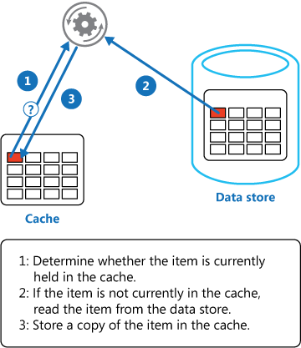
Cache-Aside
Problem Applications use a cache to improve repeated access to information held in a data store. However, it's impractical to expect that cached data will always be completely consistent with the data in the data store. Applications should implement a strategy that helps to ensure that the data in the cache is as up-to-date as possible, but can also detect and handle situations that arise when the data in the cache has become stale.
Solution Use a cache-aside strategy to emulate commercial caching systems that provide read-through and write-through/write-behind operations. Load data into the cache data on-demand.
If an application updates information, it can follow the write-through strategy by making the modification to the data store, and by invalidating the corresponding item in the cache.
When the item is next required, using the cache-aside strategy will cause the updated data to be retrieved from the data store and added back into the cache.

Slide 30
Q&A

Slide 31
The “evolution” of application platforms &

Slide 32
What is the right size of
servers for my business needs?
How do I deploy new code to my server?
What media should I
use to keep backup?
What happens in case of
server hardware failure?
Which packages should be on my server?
What size of servers
should I buy?
Who monitors
my App?
How often should I backup my server?
How can I scale my app?
How can I increase server utilization?
Who has physical
access to my servers?
Which OS should I use?
Do I need secondary network connection?
Are my server in a
secure location?
What happens if the
power goes out?
Who monitors
my Servers?
Do I need a UPS?
What storage I need to use?
How many servers
do I need?
How can I dynamically configure my app?
It takes how long to provision a new server?
How often should
I patch my servers?
On-Premises

Slide 33
What is the right size of servers for my business needs?
How can I increase server utilization?
How many servers do I need?
How can I scale my app?
How often should I patch my servers?
How do I deploy new code to my server?
How often should I backup my server?
Which OS should I use?
Which packages should be on my server?
Who monitors my App?
On-Premises
IaaS

Slide 34
What is the right size of “servers” for my business needs?
How can I increase “server” utilization?
How many “servers” do I need?
How can I scale my app?
On-Premises
IaaS
Managed

Slide 35
How do I architect my app?
Serverless, the architecture for next gen apps
On-Premises
IaaS
Managed
Serverless
PaaS

Slide 36

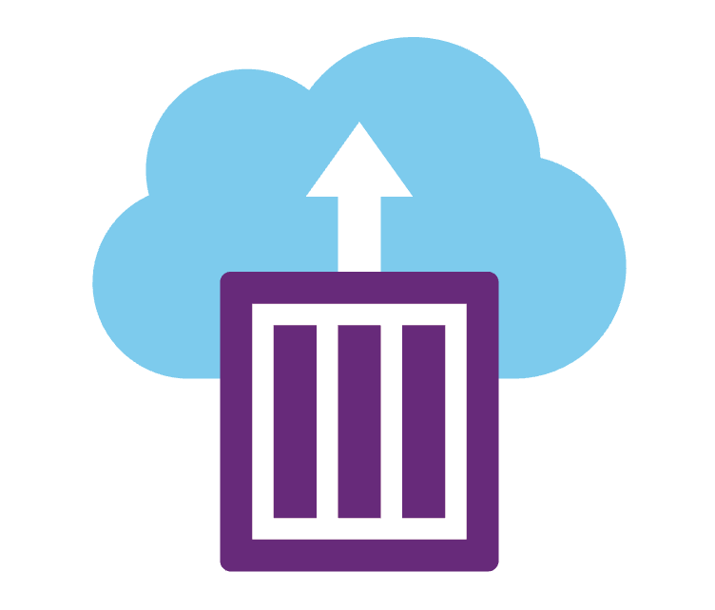



Azure Cloud App compute offerings
Azure Kubernetes Service
Container Instances
App Services
Functions
Events

Slide 37
Azure Kubernetes Service (AKS)
Fully managed Kubernetes orchestration service
Auto patching, auto scaling, auto updates
Use the full Kubernetes ecosystem (100% upstream)
Deeply integrated with Azure Dev Tools and services

Slide 38
Azure Kubernetes Service (AKS)
A fully managed Kubernetes cluster
Managed control pane
Automated upgrades, patches
Easy cluster scaling
Self-healing
Cost savings
Managed
Application architect
Applications
Operations
Kubernetes
Infrastructure architect
Docker
Azure infrastructure services

Slide 39
From infrastructure to innovation
Managed Kubernetes empowers you to do more
Focus on your containers and code, not the plumbing of them.
Responsibilities | DIY with Kubernetes | Managed Kubernetes on Azure
Containerization
Application iteration, debugging
CI/CD
Cluster hosting
Cluster upgrade
Patching
Scaling
Monitoring and logging
Customer
Microsoft

Slide 40
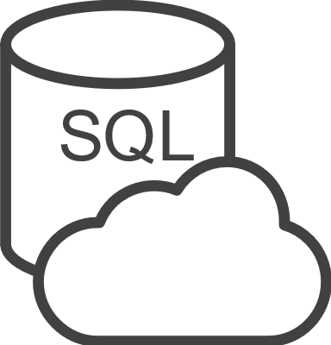
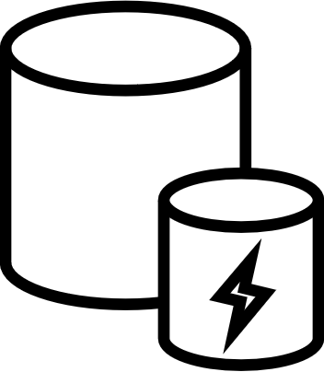




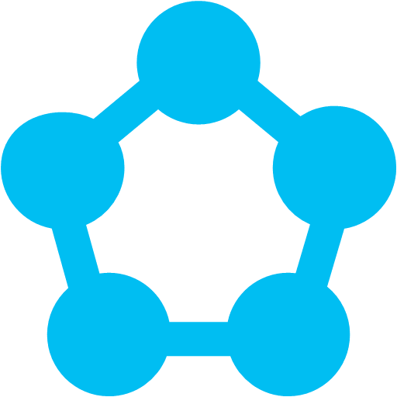
Open Service Broker for Azure
Azure SQL Database
Redis Cache
CosmosDB
And more!
Open Service Broker for Azure (OSBA)
OpenShift
Cloud Foundry
Service Fabric
Kubernetes (AKS)

Slide 41
Azure Container Instances (ACI)
Deploy containers with a single command
Launch container instances in seconds
Cost effective per second billing
Virtual Kubelet to deploy with K8s

Slide 42
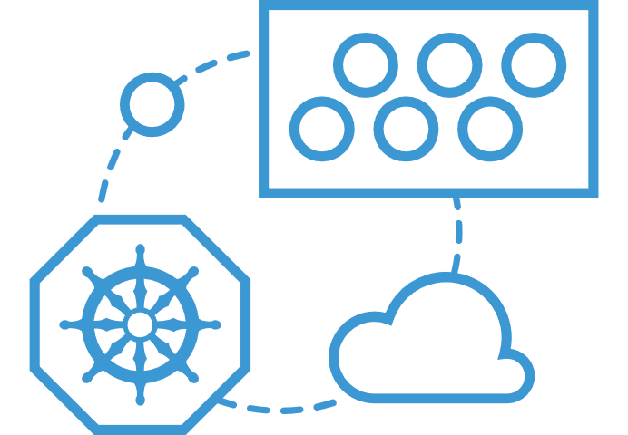
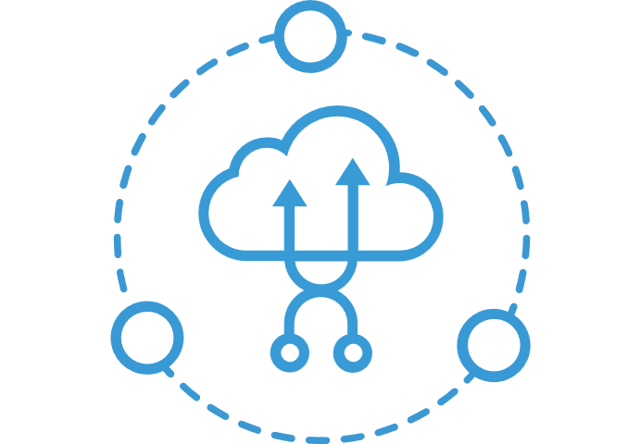
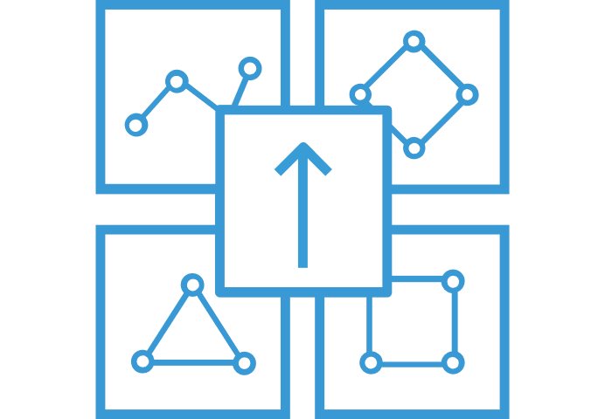
What can you build with ACI
Azure Container Service (AKS) can use the Virtual Kubelet to provision pods inside ACI that start in seconds. Then ACI provides fast, isolated compute to meet traffic that comes in spikes, without the need to manage servers.
Combine ACI with the ACI Logic Apps connector, Azure queues, and Azure Functions to build robust infrastructure that can elastically scale out containers on demand.
Use Azure Container Instances for data processing where source data is ingested, processed, and placed in a durable store such as Azure Blob storage. Achieve significant cost savings through per-second billing.
Elastic bursting with AKS
Event-driven applications with Azure Logic Apps
Data processing jobs

Slide 43
Nodeless Kubernetes (AKS + ACI)
VM
VM
Pod
Waste
Pod
Pod
Pod
Waste
Pod
Pod
Pod
Pod
Azure Container Instances (ACI)
Pod
Pod
Pod
Pod
Pod
Application architect
Kubernetes control pane
ACI Connector
Pod
Pod
Pod
Pod
Pod
Pod
Pod
Pod
Pod
Pod
Pod
Pod
Pod
Pod
Pod
Deployment/ tasks
Pod
Pod
Pod
Pod
Pod
Infrastructure architect
Pod
Waste
Pod
Pod
Pod
Waste
Pod
Pod
Pod
Pod
VM
VM

Slide 44
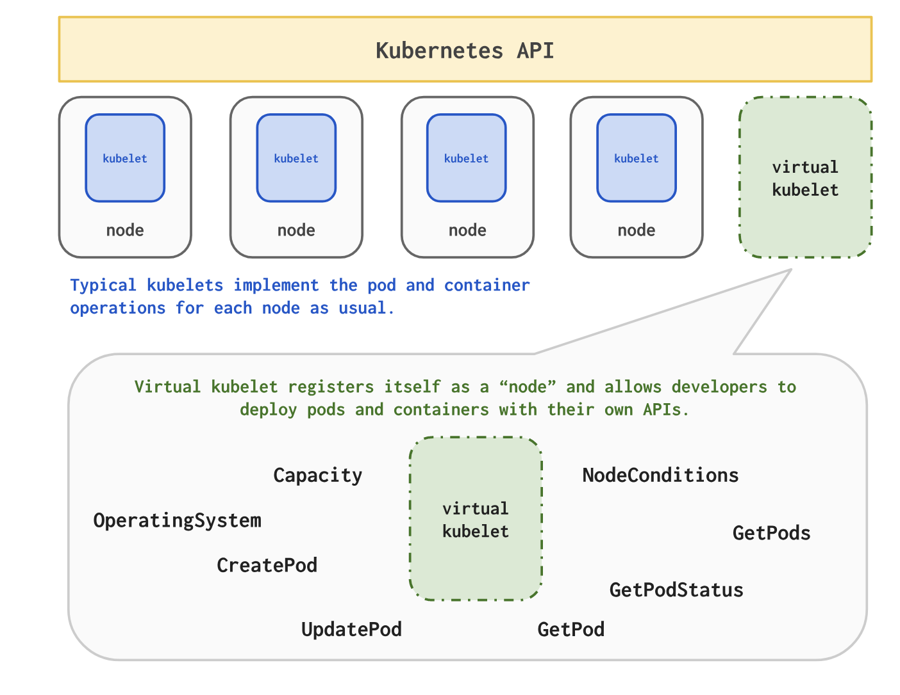
Virtual Kubelet

Slide 45
Azure Functions
On-demand serverless code
Develop, debug, deploy in Visual Studio & Visual Studio for Mac
CI/CD support in Azure DevOps and Github

Slide 46
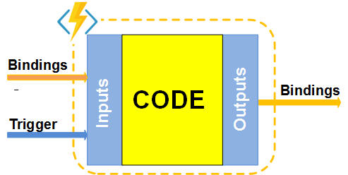
What is Azure Functions?
Open Source Project https://github.com/Azure/Azure-Functions
Programming Model
Function as the unit of work
Functions are executed; they start and finish
Functions have triggers
Functions can have inputs and outputs (bindings)
Supported Languages
C#, F#, Javascript, Java (Preview), Python (Preview)
Tooling Options
Portal, Visual Studio, VS Code, CLI, Maven (Java)

Slide 47

What is Azure Functions?
Binding
Code
Binding
Inputs
Outputs
Trigger

Slide 48


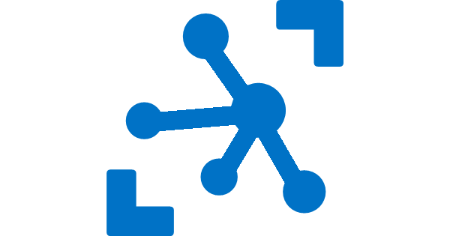
Ways to Run Functions
Consumption
Serverless
App Service Plan
Free, Basic, Standard, Premium
App Service Environment
Network Isolation
Azure Stack
On Premises
Azure Functions Runtime (preview)
Functions on your Server
Azure IoT Edge (preview)
On Devices
Pay only for what you use! Metering is per execution and per GB Second.
All the advantages of Functions with the SLA and ‘always on’ features of an App Service Plan.
Your own dedicated cloud environment with network isolation for apps, higher scale, and the ability to connect securely to local vNets.
Leverage cloud innovations in on-premises infrastructure. Azure Stack brings the power of Azure to your own data centers.
Run on IoT Devices by deploying custom modules.
Run your Azure Functions on your local server (without the rest of Azure)

Slide 49

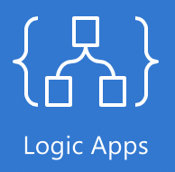


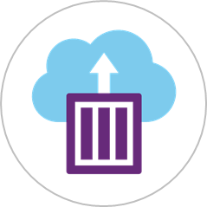






Microsoft Azure Serverless Platform
Events
Serverless Code/
Serverless Workflow
and Integration
Blob Storage
Functions
Resource Groups
Event Grid
Serverless Platforms
Azure Subscriptions
ACI
SF Mesh
Event Hubs
Other services and applications
Custom Events (anything)
Azure Automation
WebHooks (anything)
+ more

Slide 50

Azure App Service
Enterprise Grade Apps
Fully managed platform
High productivity development

Slide 51
Azure App Service
Quickly build, deploy and scale powerful cloud applications without worrying about infrastructure
High productivity
.NET, Node, Java, Docker, PHP, Ruby, Python
Staging & deployment
Testing in production
App gallery marketplace
Fully managed
Auto scale & load balancing
High availability w/ auto patching
Reduced operations costs
Backup & recovery
Enterprise grade
Global data center footprint
Hybrid support
AAD integration
Secure & compliance

Slide 52
Enterprise grade
Get the control you want with a variety of hosting options
Azure App Service (multi-tenant)
App Service Environment
Get your Web, API, or Mobile App created in seconds in the cloud. We provide the plumbing, you provide the application code or container(s).
Run your apps in virtual network at high scale. Create an isolated environment specifically for your organization and access/manage all of the resources behind your public endpoint.

Slide 53


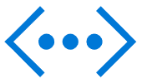
Layered security
Enterprise scale
Hybrid connectivity
Network isolation
Built-in auto scale and load balancing
Network Security Groups
App Service Environment
Run business-critical web apps in a virtual network
Application Gateway
Upgraded CPU and capacity
VPN
AAD integrated
Global data center footprint
Express routes
API security
High availability w/ auto-patching
VNET peering

Slide 54

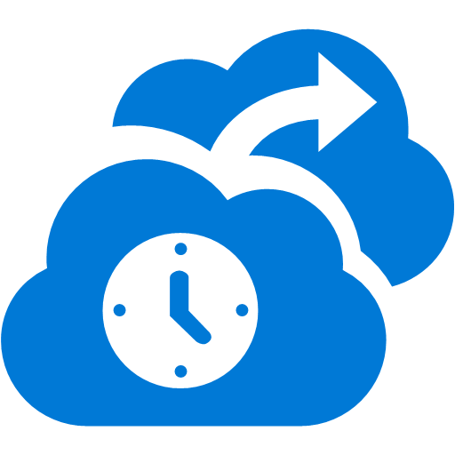






Differentiators of App Service
$
Cut costs 60–90% by moving Apps to Azure; Pay only for what you use and never worry about capacity planning
$
Deploy and test in production at any time with no performance or availability degradation using Site Slots
Global reach and presence with 40 Azure regions. Leverage traffic manager and CDN for faster response times for global users
Continuous deployment through source code repository integration with Visual Studio Online, Git, GitHub and more
Business continuity capabilities out of the box with an Azure App Service solution using site cloning and failover
SLA
99.95% uptime SLA - financially-backed by Microsoft
Quickly provision and scale capacity; Focus on your application, while Azure takes care of the underlying infrastructure
Leverage Hybrid Connections and Virtual Network to connect Azure App Service with resources on your corporate network
Develop with a choice of popular frameworks and technologies, including .NET, Java, PHP, Python, Node.js, Ruby, and even Classic ASP
Leverage endpoint monitoring, dashboard views, automated alerts and site diagnostics, all of which are provided at no extra charge

Slide 55
We run it so you don’t have to…
Monitoring Service
Local Container / Stacks Cache
Persistent Site Storage
Incoming Request
Your Code
Front End Load balancers
App Container 1
App Container n
Spare instances
Runtime Database
Provisioning API Endpoint

Slide 56
Data Options

Slide 57

Microsoft Azure database services
Leverage a single programming surface for a consistent experience
Azure SQL Database
Azure Cosmos DB
Intelligent relational cloud database service
Globally distributed, multi-model database service
My
Azure Database for MySQL
Azure Database for PostgreSQL
Azure Database for MariaDB
Managed MySQL database service for app devs
Managed PostgreSQL database service for app devs
Managed MariaDB database service for app devs

Slide 58



Azure Cosmos DB
A globally distributed, massively scalable, multi-model database service
SQL
MongoDB
Table API
Column-family
Document
Key-value
Graph
Guaranteed low latency at the 99th percentile
Elastic scale out
of storage & throughput
Five well-defined consistency models
Turnkey global distribution
Comprehensive SLAs

Slide 59
FIVE WELL-DEFINED CONSISTENCY MODELS
CHOOSE THE BEST CONSISTENCY MODEL FOR YOUR APP
Offers five consistency models
Provides control over performance-consistency tradeoffs, backed by comprehensive SLAs.
An intuitive programming model offering low latency and high availability for your planet-scale app.
Strong
Bounded-stateless
Session
Consistent prefix
Eventual

Slide 60
GUARANTEED LOW LATENCY
PROVIDE USERS AROUND THE WORLD WITH FAST ACCESS TO DATA
Serve <10 ms read and <15 ms write requests at the 99th percentile from the region nearest to users, while delivering data globally.

Slide 61
Azure SQL Database – Everything built-in
The intelligent relational cloud database service
Intelligent performance
Scales on the fly
Business continuity
Works in your environment
Advanced threat protection
Realize automatic performance improvements from continuous assessment and innovation
Change service tiers, performance levels, and storage dynamically without downtime
Easily manage and monitor business critical functions for reliable operations
Develop your app and connect to SQL Database with the tools and platforms you prefer
Build security-enhanced apps with built-in protection and industry-leading compliance

Slide 62
Monitoring/Diagnostics

Slide 63
Monitoring & diagnostics
Host machine
CPU, Memory, Disk, Network
Containers
CPU, Memory, Disk, Network
Container events
Link container data to host data
Services
Log aggregation & analytics
Use activity or correlation id’s
Consider an agent as an operations adapter
Use a common log format (UTC)

Slide 64
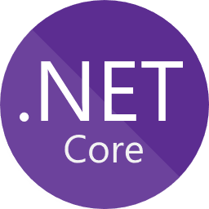


Diagnostics and Monitoring
Use your favorite APM platform to monitor apps inside containers
Containers write out stdout/stderr logs
Azure Monitor for platform events and container metrics
Service
stdout/stderr
Container
Volume
AppInsights SDK
Code
Azure Application Insights
Platform events & metrics
Azure Compute
Azure Monitor

Slide 65
Azure Monitor

Slide 66
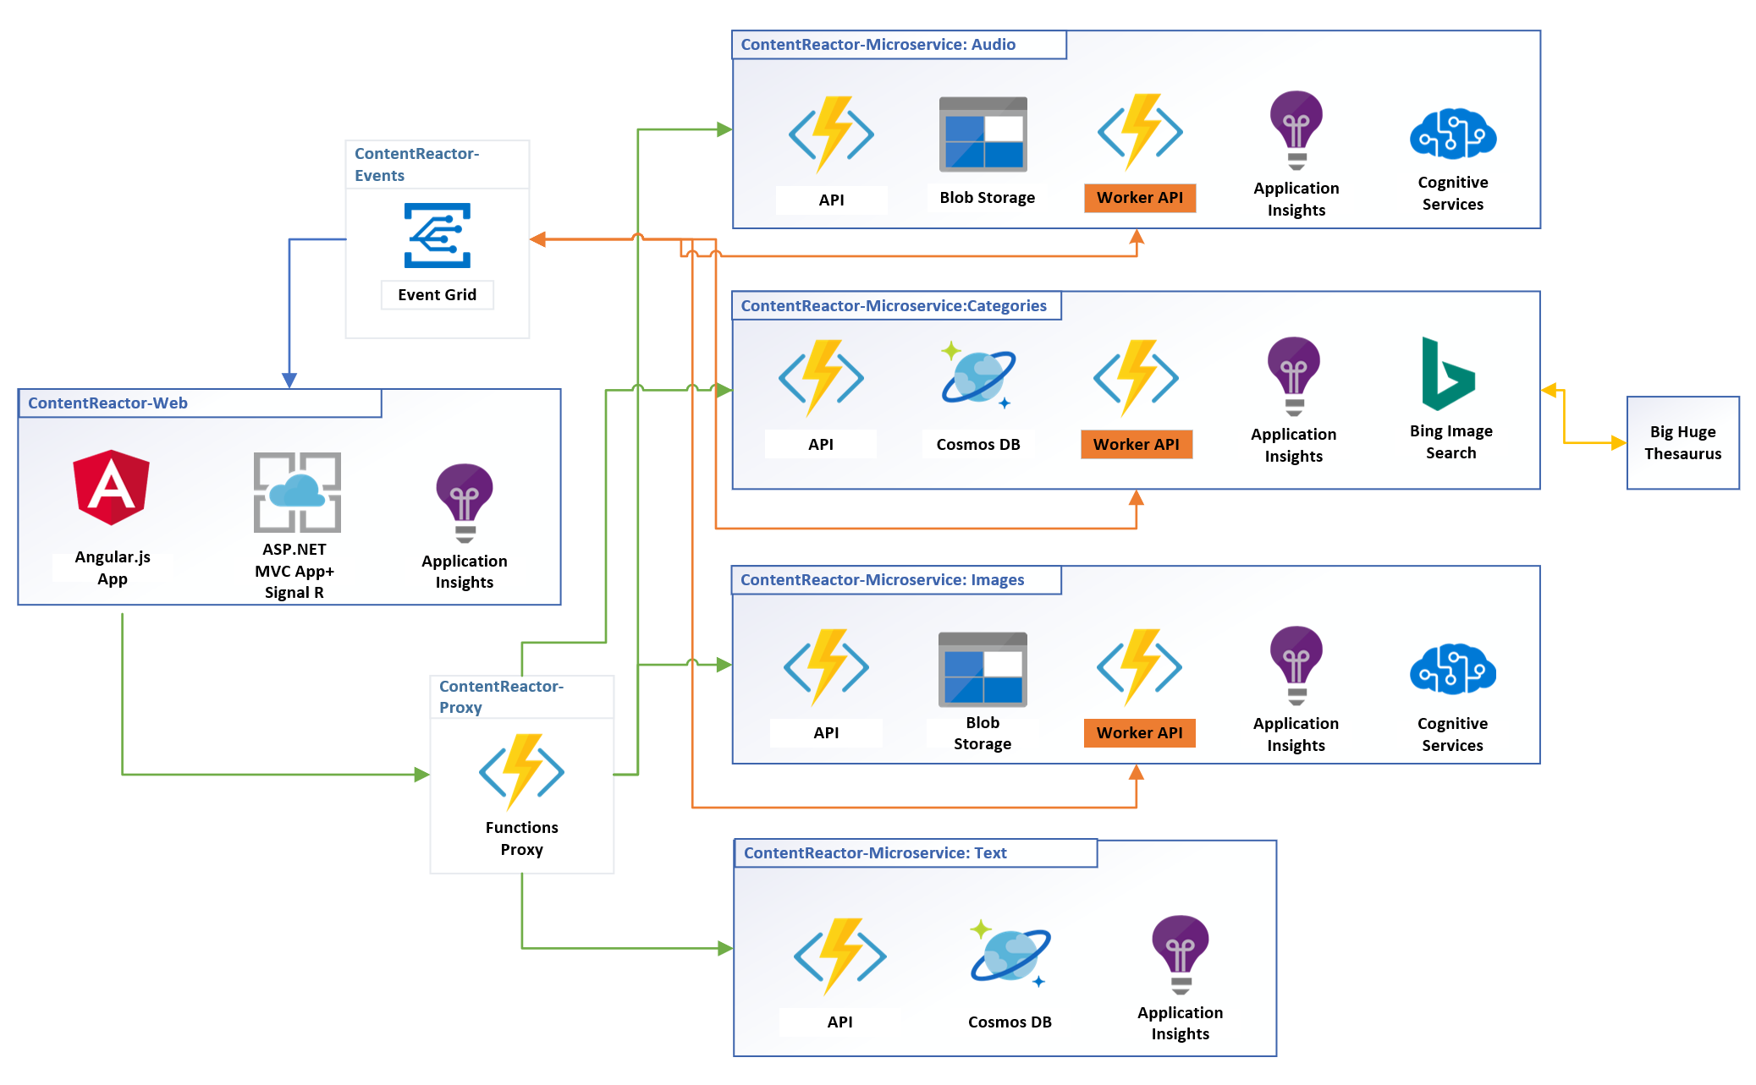
Microservices using App Services and Functions

